Slide 1


PRESENTER: TSHEPSIO SINYOSI
ST10457536_GR03_PROG6212_IIEMSA
Contract Monthly Claim System (CMCS):
Introducing a comprehensive web-based solution for automating the contract claims process and ensuring POE compliance.

Slide 2






The Challenge: Manual Claims Processing
1
Lack of real-time status visibility for Lecturers.
2
Heavy administrative burden for HR/Payroll.
3
Slow, error-prone manual calculations.

Slide 3
SOLUTION : Introducing CMCS
Automated Claims Processing
Streamline the entire contract claims submission and approval workflow
Centralized Claims Repository
Maintain a secure, database(SSMS) of all contract claims and supporting documentation
Compliance Assurance
The Right Data, To the Right Person, at the Right Time.
Real-time Visibility
Access comprehensive dashboards and reports to monitor the status of all contract claims
Seamless Integration
Integrate CMCS with your existing contract management and ERP systems

Slide 4
Key Features
Automated Claims Submission
Intelligent Workflow Management
Real-time Visibility
CMCS allows users to seamlessly submit claims through a user-friendly web interface, eliminating the need for manual paperwork and ensuring consistent data entry.
The platform streamlines the claims approval process by automatically routing claims to the appropriate approvers based on predefined rules and escalation protocols.
CMCS provides stakeholders with a centralized dashboard to monitor the status of all claims, enabling real-time tracking and reporting.
Pre-Submission Validation
Customizable Reporting
System checks for required fields, valid hours, and prevents duplicate submissions for the same month.
Users can generate detailed reports and analytics to gain insights into claims trends, identify areas for improvement, and support data-driven decision making.
Instant Auto-Calculation: Lecturer inputs Hours and Rate; the system automatically calculates the Total Amount in real-time.

Slide 5






CMCS Workflow
Claim Submission
Automated Validation
Coordinator Approval
Manager
Payment Processing
Reporting and Analytics
Oversight
The user submits a claim within the CMCS system, providing all the necessary details and supporting documentation.
CMCS automatically verifies the claim, checking for completeness, accuracy, and compliance with predefined rules and requirements.
The claim is routed to the appropriate coordinator for review and approval, with the ability to add comments or request additional information.
For claims exceeding a certain threshold, the system escalates the approval process to an executive level for final sign-off.
Once approved, the claim is automatically processed for payment, streamlining the financial settlement of the contract.
CMCS generates comprehensive reports and dashboards, providing visibility into the claims history, approval trends, and overall process performance.

Slide 6
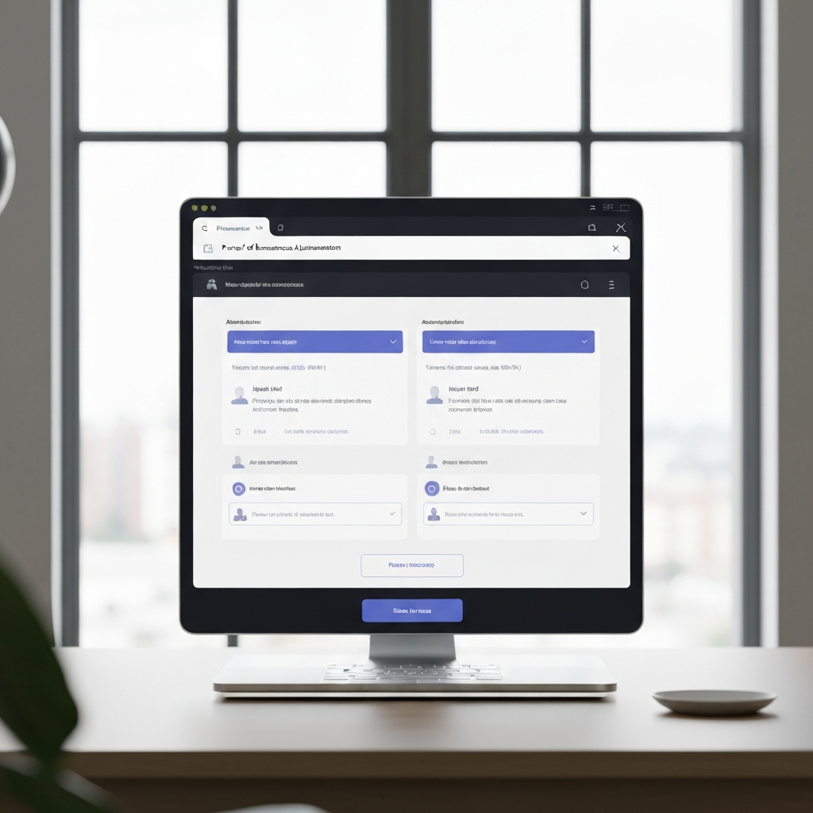
POE Compliance Automation
CMCS automates the Proof of Execution (POE) compliance process by seamlessly integrating with your contract management workflows. Through intelligent document processing and electronic signature capabilities, CMCS ensures that all required documentation and approvals are captured and archived, providing a comprehensive audit trail to meet regulatory requirements.

Slide 7
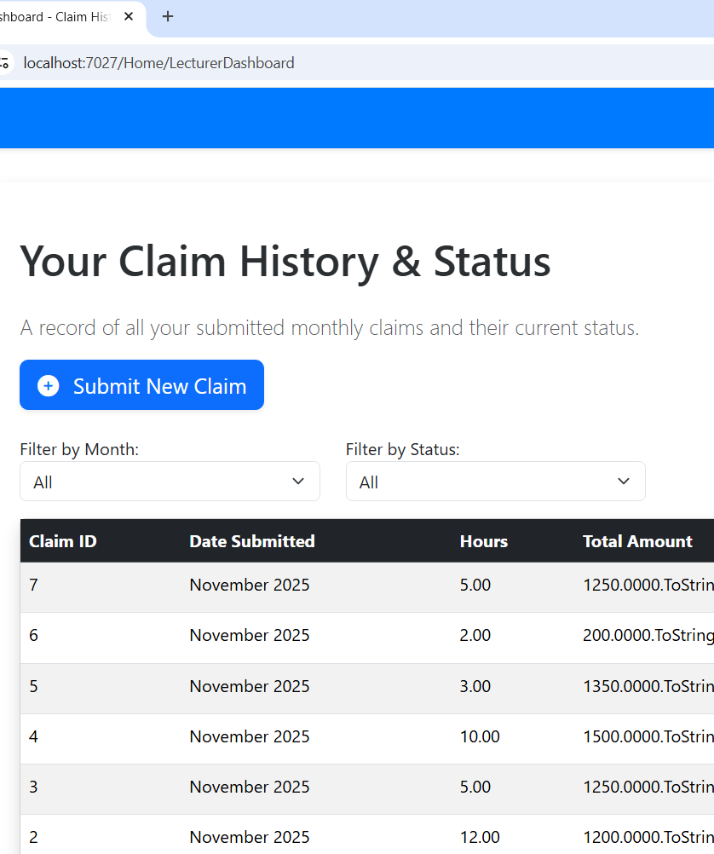
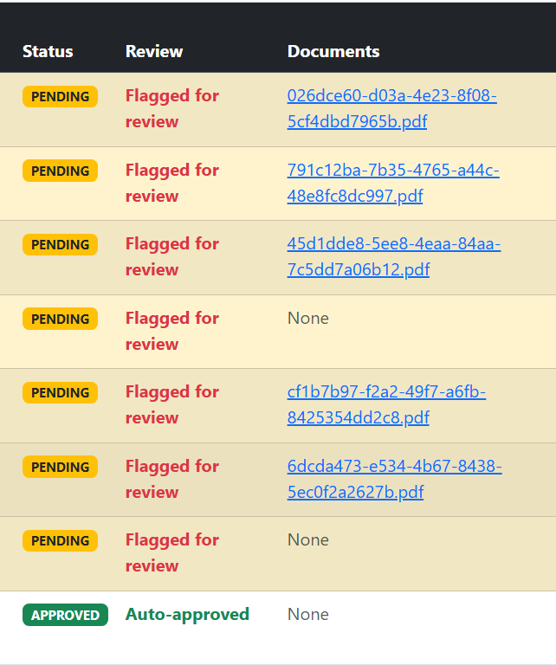
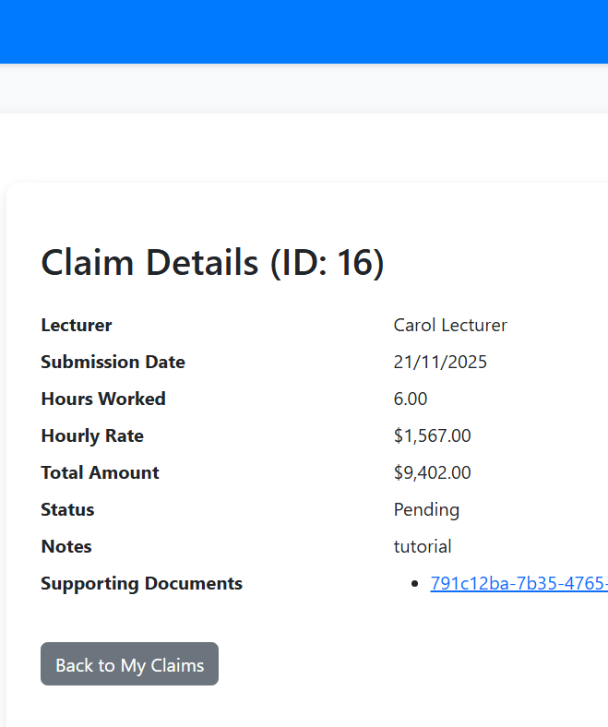
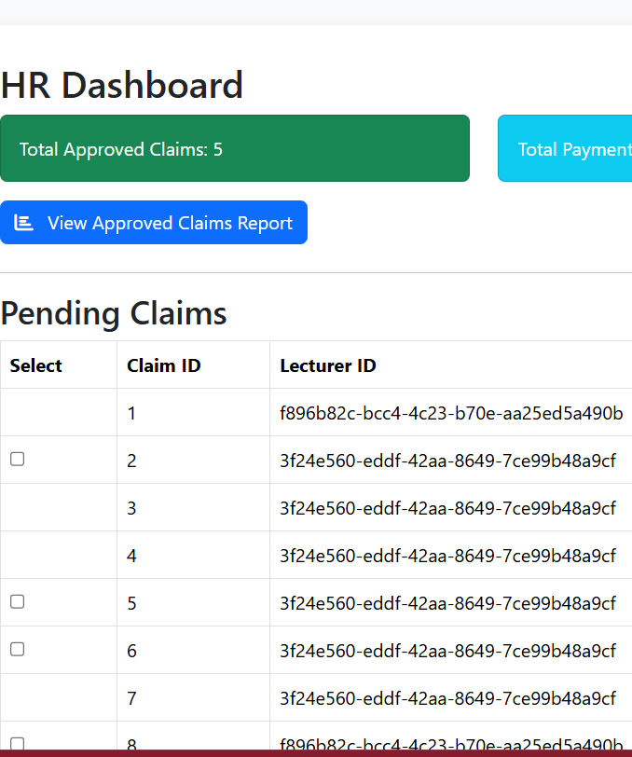
CMCS in Action
Streamlined Claims Submission
Automated Approval Workflow
Real-Time Data Insights
Seamless POE Compliance
Dashboards providing data-driven insights to optimize performance
Automated compliance with Proof of Execution requirements
A user-friendly interface for seamless claims submission
Visualizing the step-by-step approval process within CMCS

Slide 8








Key Statistics
Percentage improvements in key performance metrics after CMCS implementation
75%
85%
95%
90%
Claims Processing Time
Manual Effort Reduction
Compliance Rate
Customer Satisfaction

Slide 9
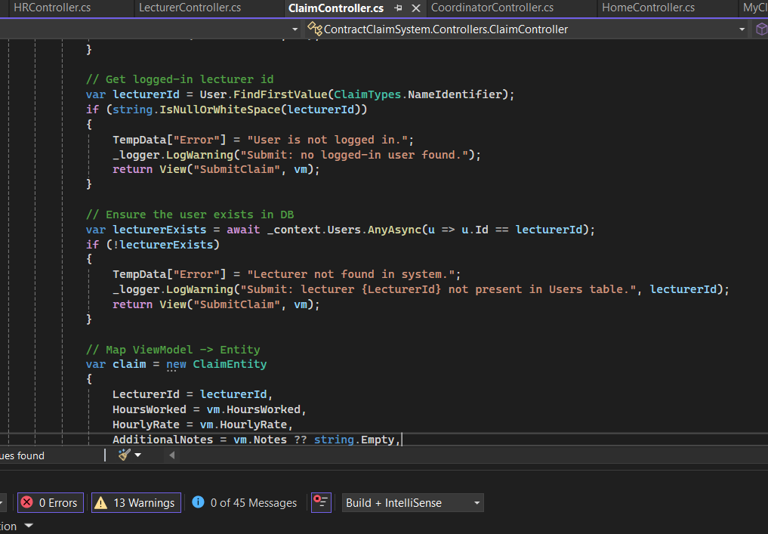
Reliable, Secure, and Ready for Your Institution
Technical Stack
Security
Built on ASP.NET Core MVC and C# for security, scalability, and ease of integration with existing systems.
Role-Based Access Control (RBAC): Ensures sensitive HR/payroll data is only accessible to authorized personnel.
Financial
Team
We offer future-proof reliability built on the Microsoft stack, minimizing long-term maintenance costs.
Relevant qualifications or background

Slide 10

The Contract Monthly Claim System (CMCS) is a powerful web-based solution that streamlines the claims submission and approval process, while ensuring seamless compliance with Proof of Execution requirements. By automating the workflow and providing a centralized platform, CMCS empowers organizations to increase efficiency, reduce manual effort, and maintain regulatory compliance. With CMCS, organizations can revolutionize their contract management practices and unlock the full potential of their claims management processes.

